Slide 1
Distributed Algorithms 2018/19 Fault Tolerance
Danh Le-Phuoc | Open Distributed Systems
With material from R. Karnapke @ KBS & O. Kao @ CIT

Slide 2
Overview
Introduction into fault tolerance
Masking fault tolerance
Redundancy techniques (only sketched)
Consensus and related problems
Non-masking fault tolerance
Self-Stabilization

Slide 3
Fault Tolerance
No (non-trivial) system contains no fault!
Taking faults into account is, thus, absolutely necessary!
In large systems (e.g., the Internet) some components will always work faulty
Simple motivation: All computers of a systems must be available at the same time (→ serial composition)
1 computer → system unavailable 1% of the time
10 computers → system unavailable ~10% of the time
100 computers → system unavailable ~63% of the time
1000 computers → system unavailable ~99.99% of the time
Example university computer room: How often are all computers in a large room functional at the same time?

Slide 4
Basic Terms
Fault
Triggering event, e.g., caused by external disturbance or wear/abrasion
Error
Internal system state that does not fit the specification, caused by a fault
Failure
System does not provide the correct service to the outside, caused by an error
This chain might abort after every step, a failure is not always the consequence
Fault
Error
Failure

Slide 5
Classification of Faults– Benign Faults
Crash Fault: A node suddenly fails and afterwards no actions are exercised, but until the moment of the fault it behaves according to its specification,
Also denoted Halting fault or Fail Stop etc. Often, those terms additionally mean that the fault can be surely determined by all nodes that have not failed
Omission Fault: Some actions are not exercised
Timing Fault: Specification suitable behavior, but some actions are carried out too late
All have in common: The faulty process does not exercise any actions that a correct process would not do
Not always realistic!

Slide 6
Classification of Faults– Malicious Faults
Often denoted as Byzantine faults (Lamport, 1982)
Faulty processes can exercise arbitrary actions and cooperate among each other
For example, exercise arbitrary calculations and send arbitrary messages
Often, also limited model
E.g., faulty processes can exercise arbitrary actions calculable with polynomial complexity (i.e., they cannot fake digital signatures of correct nodes)
Model covers all kinds of faults, e.g., it also targets attacks on a system from outside
Model also contains all “simpler” cases

Slide 7
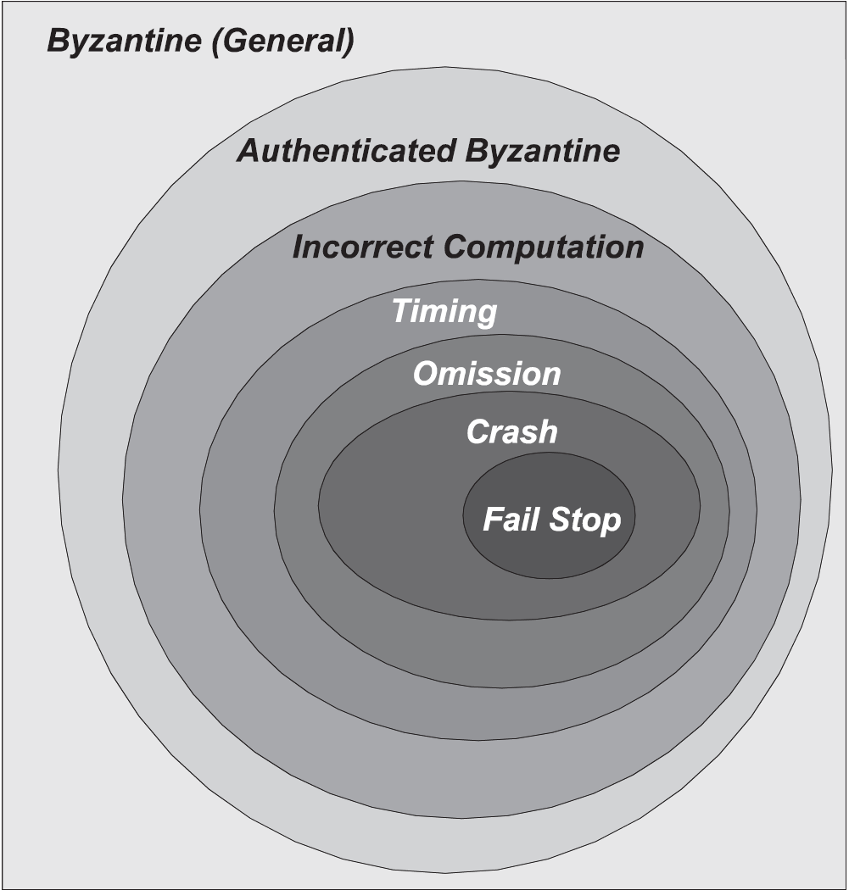
Example: Fault models for Distributed Systems

Slide 8
Approaches
Fault intolerance
Idea: “Avoid faults!”
Eliminating fault causes
Very reliable components
Extensive testing
…
Fault tolerance
Idea: “Faults occur, we tolerate them!”
Fault tolerance by redundancy in space and/or time
Acceptance of partial or temporal failures
→ Considered here

Slide 9
Paradigms of Fault Tolerance
Masking fault tolerance
Aim: avoid system failure if possible
Non-masking fault tolerance
System may fail partly or temporarily
Better than a complete and/or permanent failure

Slide 10
Masking Fault Tolerance
Necessary if a (also temporary) failure of the system would have inacceptable consequences
e.g., death of humans or high financial losses
Sensible also with many other applications
Tries to ensure safety and liveness!
Example car brakes
Separated brake circuits for right front wheel and left back wheel as well as for left front wheel and right back wheel
Car can still break if one circuit has failed

Slide 11
Masking Fault Tolerance
Always needs redundancy for implementation
Always only possible for the faults considered
Can never take into account all possible faults
Only successful if only a limited part of the components is erroneous
The amount of the erroneous components that can be tolerated depends on the fault model

Slide 12
Redundancy in Space or Time
Redundancy in Space: multiple instances of components
example: a server has several independent power supplies
single, functioning power supply sufficient
erroneous power supplies are substituted without disrupting server operation
Redundancy in Time: multiple execution of actions
example: packages are submitted several times over an unreliable network; from those packages, an error free package is generated (if possible)

Slide 13
Active and Passive Replication
Active Replication
All replicas collaborate productively
e.g. eyes, aircraft engines, brake systems,...
TMR (Triple Modular Redundancy)
Passive Replication
Replicas only get active in case of an error (primary/backup)
e.g., spare tire (no masking), emergency power generator
A₁
x
Voter
y
x
A₂
A₃
x
Notes:
TMR: Komponente ist dreifach vorhanden. Voter bildet die Mehrheitsentscheidung.

Slide 14

Fault Tolerance by Redundant Components
k-reliability of a system with respect to a component that exists n times: system can tolerate the failure of up to k of the n instances of the components
Non-Byzantine fault
System with an n-times existing component is (n – 1)-reliable in reference to that component
Byzantine fault
Assumption: correct output can uniquely be determined from the n outputs by highly reliable voter
System with an n-times existing component is
reliable in reference to that component

Slide 15
Example: 1–Reliability
Consider a file server S with the operations read() and write()
Non-byzantine fault
S sends, in response to read(), either correct content or nothing
Realization with two servers S1 and S2
write(): to both servers
read(): if S1 does not reply, then S2 also possible: ask S1 and S2; use first answer
Byzantine fault
S sends either the correct content or a false content or nothing after read() is called
Realization with three servers S1, S2 and S3
write(): to all three servers
read(): to all three servers, majority vote at the client

Slide 16
Example: N-Version Programming
Application is implemented several times by independent programmer teams
Results are evaluated by majority vote at run time
Problems
Comparison of results with admissible inaccuracy (e.g., result of a numeric approximation)
Comparison of multiple possible correct solutions (e.g., zero of a polynomial)
Development often not really “independent”
…
Notes:
Nicht nur Redundanz der Hardware sondern auch Redundanz der Software wird eingesetzt

Slide 17
Problem: Hidden Dependencies
Hidden dependencies of redundant instances increase probability of simultaneous failure!
Examples?
Redundant power supplies in the same electric circuit
Redundant servers cooled by the same air condition
Redundant diesel generators sharing the diesel tank
Programming teams with same education in N-version programming
Same, faulty compiler in N-version programming
Redundant computation centers in the same area
…

Slide 18
Non-Masking Fault Tolerance
Applicable if a partial or temporary failure of the system/the component is acceptable
1. possible aim: In case of an error, bring the system into a safe state (fail safe)
Assures safety
Example: traffic light control
In case of an error of the traffic light control, all traffic lights are switched to red
Example: mechanic stop sign for trains
When the signal rope is torn, the arm of the signal falls into the position “Stop!”

Slide 19
Non-Masking Fault Tolerance
2. possible aim: in case of a failure, the system is run on with restricted functionality (graceful degradation)
Assures safety and limited liveness
Example servo steering
In case of the failure of the servo pump, steering is still possible, but only with higher effort
Example ABS brake
In case of electronic failure, the brake is still operational without ABS functionality

Slide 20
Non-Masking Fault Tolerance
3. possible aim: In case of a failure, reconfigure the system in such a way that it works correctly again
Assures safety again after reconfiguration (eventual safety)
Liveness is not affected if the reconfiguration only lasts for a limited time
Example: communication over serially connected lines
In case of the failure of one or several lines, an alternative route is set up without usage of the failed lines

Slide 21
Process Resiliency

Slide 22
Process resiliency
In distributed applications have multiple processes that rely on each other. If a process fails (e.g. due
to a node failure) other processes may no more be able to do their job. This can cause the a failing of
the entire application.
To prevent this we have to make processes resilient
Process resilience should make sure, that a distributed computation can carry on even though some of its processes failed
This is important in systems which cannot be stopped.
One possible solution for this issue is Checkpointing

Slide 23
Checkpointing
Saving (at least) the state of a process is a checkpoint
Checkpointing enables the system to be able to rollback recover. If a failure occurs, the process rolls back to the least consistent state saved in a checkpoint.
In distributed environments a processes state depends on the state of other processes, as the communicate/exchange messages between each other
Processes can thus not just rollback on their own. If a communication is discarded during rollback, the communication partner has to roll back too.
This is called rollback propagation an can lead to the scenario that the system rolls back to its initial state (domino effect)
Checkpointing can be realized coordinated, uncoordinated and semi coordinated.
Global Checkpoints that are coordinated between all processes and would prevent rollback propagation are expensive
Notes:
Docker for instance has a Checkpointing and recovery mechanism

Slide 24
Resilient RPC
Remote procedure calls enable a process, running on one node to make a call to a procedure running on another node. Those RPCs can be nested, as the called procedure may call a remote procedure itself and so on.
A single process failure will fail all other processes involved.
Primary site approach
Using process pairs, a primary and a backup.
If the primary does not exists (any more) the request is sent to the backup
The primary checkpoints each request on the backup, by sending a message
On failure the backup becomes primary
Sequence numbers can be used to avoid double execution
Notes:
If the excuting process fails the caller will be suspenden for ever
If the caller fails, the executing process has nowhere to return the results to

Slide 25
Resilient RPC
Replication call
Several replicas of the remote procedure
On call all replicas are executed
As long, as one procedure is alive the call will receive result
Depending on the of the error correction capability, the call my take the first arriving result, or wait for all results to decide which on is correct.

Slide 26
Resiliency with Asynchronous Message passing
Systems that communicate with asynchronous message passing are prone to the domino effect described before. Rolling back just the failed node to the last checkpoint leads to an inconsistent system state as the state of the rolled back processes will not include the arrival and sending of messages in-between checkpoint and failing.
In order to reach a consistent state those messages have to be recovered (if we do not want to rollback all other processes too). This asks for massages to be saved to stable storage -> Message logging
Sender based message logging
Single process failure
Messages are logged by the processes which send messages
If a process receives a message it returns a receive sequence number (RSN) to the sender
The sender add this RSN to the log. Those RSNs build a total order of the received messages
On recovery the messages are retransmitted in the RSN order, thus the failed process gets the message in the same order as last time

Slide 27


Sender based message logging example
P
A
B
As in “Fault tolerance in Distributed systems” Pankaj Jalote

Slide 28
Sender based message logging example
P
P already received 5 messages
Each process saves send sequence number and receive sequence number
A sends 4 messages, B sends 3 messages
A
B

Slide 29
Sender based message logging example
P
A
B
SSN | 1 | 2 | 3 | 4
RSN | 5 | 7 | 8
SSN | 1 | 2 | 3
RSN | 6 | 9 | 10
Notes:
The network first delivers the first message of A, then the first message of B….
The tables show the situation that A did not yet received the RSN for the last message from P
This message is partially logged

Slide 30
Sender based message logging example
P
RSN Messages have to be acknowledged too.
P is not allowed to send messages before it receives the ACK for the last RSN
A
B
SSN | 1 | 2 | 3 | 4
RSN | 5 | 7 | 8
SSN | 1 | 2 | 3
RSN | 6 | 9 | 10
Notes:
The network first delivers the first message of A, then the first message of B….
The tables show the situation that A did not yet received the RSN for the last message from P
This message is partially logged

Slide 31
Sender based message logging
If process P fails, it is restarted on another node in the state of the last checkpoint
Requests all a resending of all messages via broadcast
Messages received by P will be processed in the RSN order
Partially logged messages are send after the logged ones
There is no total order to this message, they may be processed in a different order then the last time
As P was not allowed to communicate until all ACKs of RSN messages arrived, these messages will not have an effect to other processes, a different order is thus acceptable
This approach can only handle one process failure at a time.

Slide 32
Self stabilization

Slide 33

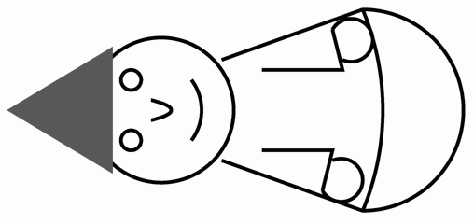
Self-Stabilizing Systems
„We call the system "self-stabilizing" if and only if, regardless of the initial state […], the system is guaranteed to find itself in a legitimate state after a finite number of moves.“ Dijkstra, 1974
Legitimate State
Illegitimate State

Slide 34
Proof of Self-Stabilization
Set of all states Z
Set of the legitimate states L ⊆ Z
To be proven: convergence and closure
Convergence: Starting from a state Z \ L, after a limited number of steps a state in L is reached
Construct a function t (termination function) from Z to ℕ, that decreases with every step and indicates with t = 0 the stabilization in the end
Closure: Starting in a state in L, each following state again is in L
Proven usually through an invariant
Z
L

Slide 35
Recovery from Transient Errors
Self-stabilizing systems recover from arbitrary transient faults if no new faults occur for a sufficient period of time
The state after the end of the last fault is regarded as „initial“ state → recovery guaranteed
The class of transient faults contains among others
Temporary network faults
Crash and following restart of processes
Arbitrary corruption of data structures
Note: Non-self-stabilizing systems fail possibly permanently even after transient faults!
Arbitrary large part of the resources can be affected by faults
Exception: program code and data in ROM cannot be corrupted

Slide 36
Self-Stabilizing Systems – Characteristics
Do not need to be initialized because they reach a legal state from every starting state
Tolerate arbitrary transient faults with one uniform mechanism
Can not know for sure whether they are stabilized
Must not terminate
Adapt to dynamic changes of the typology if possible
Do not necessarily need to detect faults to recover from them
Offer efficient solutions for many problems
Information distribution, mutual exclusion, spanning tree construction, election, …

Slide 37
Composition of Algorithms
Conventional composition of algorithms A and B
Composition of A and B
B is started when A has terminated
The output of A serves as input for B
A
B

Slide 38
Composition of Algorithms
Composition of self-stabilizing algorithms
Simultaneous execution of A and B
If A has stabilized, B is stabilized afterwards
Precondition: B writes no data that A reads
Stabilizing time of the composition is the sum of the stabilizing times of the single algorithms plus possible delays
A begins to
stabilize
A is stabilized
A
B
B begins to
stabilize
B is stabilized

Slide 39
Self-Stabilizing Token Ring (Dijkstra, 1974)
n + 1 processes are arranged in a unidirectional ring
Each process can take on one of k states (k > n) → Variable s ∈ {0, …, k – 1}
Each process can access the state of its left neighbor through a common variable left
Each process which can move anytime, will move at a time
ON bottom process (P₀): ON other process (P_{i}, i≠0):
WHILE TRUE DO WHILE TRUE DO
IF (left == s) THEN IF (left != s) THEN
‹token› ‹token›
s := (s+1) mod k; s := left;
FI FI
END END
END END
Notes:
t.

Slide 40
Self-Stabilizing Token Ring
Example trace without fault for n = 3 and k = 4
Process 0 1 2 3
State 0 0 0 0
1 0 0 0
1 1 0 0
1 1 1 0
1 1 1 1
2 1 1 1
2 2 1 1
2 2 2 1
2 2 2 2
3 2 2 2
Process executes
step and accesses
token. State after
step in next row
Process could execute step and access the token.
Notes:
Ein Prozess der das Token hat, greift auf den kritischen Abschnitt zu und zieht. Dadurch bekommt ein anderer Knoten das Token.

Slide 41
Self-Stabilizing Token Ring
Example trace with recovery from a fault for n = 3 and k = 4
Process 0 1 2 3
State 3 2 0 1
3 3 0 1
3 3 0 0
3 3 3 0
3 3 3 3
0 3 3 3
0 0 3 3
0 0 0 3
0 0 0 0
1 0 0 0
Process executes
step and accesses
token. State after
step in next row
Process could execute step and access the token.
Notes:
Ein Prozess der das Token hat, greift auf den kritischen Abschnitt zu und zieht. Dadurch bekommt ein anderer Knoten das Token.

Slide 42
Self-Stabilizing Token Ring
Original Specification
Safety: There is at most one token in the system
Liveness: At least one token circulates in the ring
Fairness: If a process can exercise anytime, it will exercise after a finite time
Self-stabilizing variant
Safety: After a finite number of steps, there is at most one token in the system
Liveness and Fairness as above

Slide 43
Self-Stabilizing Span Tree Construction
Processes {P₁, …, P_{n}} are arranged in an arbitrary, connected topology
Assumptions
Each process has a unique identity > 0, stored in its ROM
Each process has the same timeout-value ρ stored in its ROM
In the fault-free case, no messages get lost and messages have a limited message delay

Slide 44
Self-Stabilizing Span Tree Construction – Basic Idea in the Fault-free Case
Root (node with smallest ID) sends with period ρ heartbeats to all its neighbors
Nodes relay received heartbeats to all other neighbors
Each node elects the neighbor as father that lies closest to the root
In case of equality, the node with smaller ID is elected
Received heartbeat suppresses the desire of other nodes to become the root → delivery in time must be ensured
7
4
3
9
5
10
1
2
11
13
12
14
15

Slide 45
Self-Stabilizing Span Tree Construction – Basic Idea in Case of a Fault
If a connection fails, another spanning tree with the same root node forms
If the root fails or if the root is no longer reachable, another spanning tree with a different root node forms
In both cases, the trigger for the formation of a new spanning tree is the occurrence of timeouts
If the fault is transient, the original spanning tree forms again, after, e.g., the node is available again
7
4
3
9
5
10
1
2
11
13
12
14
15

Slide 46
Self-Stabilizing Span Tree Construction
Each process P has
a variable P_{V} that points at one of its neighbors (its father)
a variable P_{W} that points at the current root
a variable P_{L} that indicates its level in the tree and
a variable P_{F} that is read out in case of a timeout and possibly changed
Aim: After finite time the P_{V} –references of all nodes shall form a spanning tree
Remark for the next slide:
(v₁, v₂, v₃) < (w₁, w₂, w₃) ⇔ v₁ < w₁ ∨ (v₁ = w₁ ∧ v₂ < w₂) ∨ (v₁ = w₁ ∧ v₂ = w₂ ∧ v₃ < w₃)

Slide 47
Self-Stabilizing Spanning Tree Construction
A node P receives a message (w, l, i)
If (P_{W}, P_{L}, P_{v}) < (w, l + 1, i) or P < w, the node ignores the message → Message is not eligible
If (P_{W}, P_{L}, P_{v}) = (w, l + 1, i), it sets P_{F} to 2 and sends a message (P_{W}, P_{L}, P) to all other neighbors → Eligible refresh message from current root
Otherwise, it sets (P_{W}, P_{L}, P_{v}) := (w, l + 1, i) and P_{F} := 2 and sends a message (P_{W}, P_{L}, P) to all other neighbors → New root
Fault-free Case
Faulty Case

Slide 48
Self-Stabilizing Spanning Tree Construction
When the timeout (ρ) occurs at process P:
If P_{F} ≤ 0, it sets (P_{W}, P_{L}, P_{v}) := (P, 1, P), leaves P_{F} unchanged and sends a message (P_{W}, P_{L}, P_{v}) to all neighbors → Node declares itself to new root node
If P_{F} = 1, P_{F} := 0
If P_{F} ≥ 2, P_{F} := 1
In every case, the timer is reset and restarted
Fault-free Case
Faulty Case

Slide 49
Self-Stabilizing Span Tree Construction
7
4
3
9
(9,1,9)
5
10
2
(1,1,1)
1
11
13
12
14
15
(Root, Level, Father)
Notes:
Bei den Knoten 1 und 9 läuft gleichzeitig der Timeout ab.

Slide 50
Self-Stabilizing Span Tree Construction
Nodes 5 and 7 ignore the message
of node 9!
(1,2,1)
7
4
3
9
(9,1,9)
5
(1,2,1)
10
2
(1,1,1)
1
11
(9,2,9)
(1,2,1)
13
12
14
(1,2,1)
15
(Root, Level, Father)

Slide 51
Self-Stabilizing Span Tree Construction
(1,3,3)
(1,3,3)
(1,2,1)
7
4
3
9
(9,1,9)
5
(1,2,1)
(1,3,2)
(1,3,3)
10
2
(1,1,1)
1
11
(9,2,9)
(1,2,1)
13
12
14
(1,2,1)
(1,3,2)
15
(9,3,11)
(Root, Level, Father)

Slide 52
Self-Stabilizing Span Tree Construction
(1,3,3)
(1,3,3)
(1,2,1)
7
4
3
9
(1,4,5)
5
(1,2,1)
(1,3,2)
(1,3,3)
10
2
(1,1,1)
1
11
(1,4,14)
(1,2,1)
13
12
14
(1,2,1)
(1,3,2)
15
(1,4,14)
(Root, Level, Father)

Slide 53
Characteristics of the Constructed Spanning Tree / Proof of Convergence
Constructed tree is unique in the fault-free case because
the process with the smallest identity becomes the only root and
each process, except for the root, elects that process as its predecessors that has the smallest identity among the neighbors with the smallest level
In the fault-free case, only the refreshment messages triggered by the root are on the way
The system is in a legal state if
The state of the processes conforms to the spanning tree introduced above and
No faulty messages are on the way anymore
To prove convergence it has to be shown that the system, starting from an arbitrary state, reaches a legal state

Slide 54
Ensuring Closure
Each node except for the root node always has to receive a refreshment message in time, otherwise it would declare itself as root
Let δ_{min} be the minimal and δ_{max} the maximal message delay on a link and d the length of the longest path in the topology
The height of the resulting tree is always less than or equal to d
The maximal time between two refreshment messages occurs
if the root and the considered node are maximally far away from each other (max d hops) and
the 1st message is minimally (→ d δ_{min}) and
the 2nd message is maximally (→ d δ_{max}) delayed

Slide 55
Ensuring Closure
The receipt of the first refreshment message sets P_{F} to 2
The first timeout (which sets P_{F} to 1) can occur directly after the receipt
The second refreshment message has to arrive before two further timeouts occur
a₀ = t₀ + d δ_{min}
a₁ = t₁ + d δ_{max}
t₁ = t₀ + ρ
t₀
t₁
2ρ > a₁ – a₀
ρ
d δ_{max}
Root
⇒
1
2
2ρ > ρ + d (δ_{max} – δ_{min})
Max.
d hops
⇒
ρ > d (δ_{max} – δ_{min})
d δ_{min}
2ρ
a₀
a₁

Slide 56
Literature
G. Coulouris, J. Dollimore, and T. Kindberg. Distributed Systems: Concepts and Design. Addison-Wesley, 4th edition, 2005. Chapter 17
Pankaj Jalote Fault Tolerance in Distributed Systems April 1994
D.K. Pradhan (Hrsg.): Fault Tolerant Computer Systems, Prentice Hall, 1996
D.P. Siewiorek, R.S. Swarz: The Theory and Practice of Reliable Systems Design, Digital Press,
1995
E. W. Dijkstra. Self-Stabilizing Systems in Spite of Distributed Control. Communications of the ACM, 17(11):643--644, 1974.
S. Dolev. Self-Stabilization. MIT Press, 2000.
M. Schneider. Self-stabilization. ACM Computing Surveys, 25(1):45--67, 1993.
F. C. Gärtner. A survey of self-stabilizing spanning-tree construction algorithms. Technical Report 200338, Swiss Federal Institute of Technology (EPFL), School of Computer and Communication Sciences, Lausanne, Switzerland, June 2003.

